Slide 1
Common data architectures
Star Schema
Operational Data Store Consolidation & Aggregation

Slide 2
Star Schema
DISTSTYLE ALL
Small Dimension Table
DISTSTYLE ALL
1
Small Dimension Table
DISTSTYLE ALL
2
3
Large Dimension Table
Dimensionless Dimension
DISTSTYLE EVEN
Fact Table
4
Notes:
1. Small Dimension tables should be marked as `DISTSTYLE ALL`, which will cause them to be replicated to each physical node in the cluster.
2. Wherever possible, denormalise single dimension values onto the Fact table. An example of this would be a postal code, if you do not need to store any additional information about each postal code value. This would be in contrast to using an 'Address' Dimension.
3. Large Dimension tables are also marked as `DISTSTYLE ALL`.
4. Fact tables are marked as `DISTSTYLE EVEN`, which will cause data to be placed onto each [Slice](https://docs.aws.amazon.com/redshift/latest/dg/c_high_level_system_architecture.html) in the cluster evenly.

Slide 3
Star Schema
DISTSTYLE ALL
Small Dimension Table
DISTSTYLE ALL
Small Dimension Table
DISTKEY N
Large Dimension Table
Dimensionless Dimension
DISTKEY N
Fact Table
1
2
Notes:
1. In this model we have a very large Dimension table, and we distribute the Dimension table by it's primary key value
2. The Fact table is also distributed by this Dimension key column value.

Slide 4
"Snowflaking"
DISTSTYLE ALL
1
Snowflake Dimension Table
DISTSTYLE ALL
Small Dimension Table
DISTSTYLE ALL
1
Snowflake Dimension Table
DISTKEY N
Large Dimension Table
Dimensionless Dimension
DISTKEY N
Fact Table
DISTKEY N
2
Snowflake Dimension Table
Notes:
1. In most cases, you will want to mark related Dimension tables (the Snowflakes) as `DISTSTYLE ALL`, so that they are distributed to each node in the cluster
2. However, in some cases, and particularly if you are using Key based distribution of a large Dimension and Fact combination, it may be possible to also distribute these related lookup tables by the same key value.
Because of columnar compression, denormalising key values onto 'parent' tables is relatively inexpensive to store, and can provide significant performance improvements. However, this can only be used if the cardinality of the Snowflake table to the Dimension table is 1:1 or M:N.

Slide 5
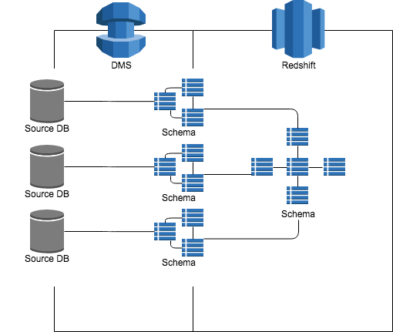
Operational Data Store Consolidation & Aggregation
1
4
3
2

Slide 6
Common deployment architectures
Simple, single cluster with reporting tools
ETL Cluster with multiple line-of-business reporting clusters
Spectrum Multi-Cluster
High performance, low latency hybrid clusters

Slide 7
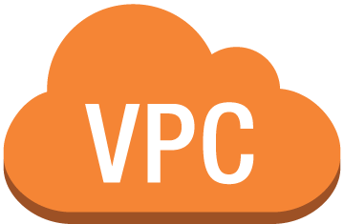

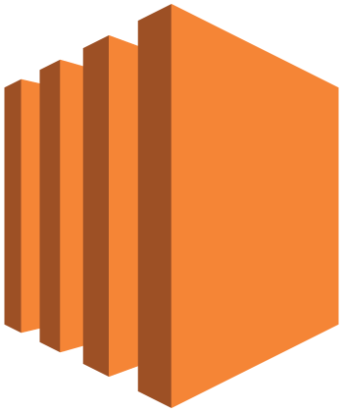

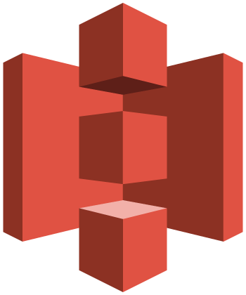
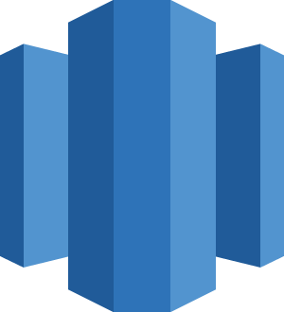
Simple, single cluster with reporting tools (public routing)
Availability Zone
Availability Zone
Public Subnet
Public Subnet
3
Security Group
Cluster Subnet Group
2
4
1
Internet gateway
Amazon S3
Amazon WorkSpaces
Third Party Reporting
Redshift Cluster
Notes:
1. In this architecture, we deploy Redshift to VPC, as will be the case for all our other architectures. Redshift is created in a public VPC Subnet in the AZ of your choice
2. In order to create the cluster, we must configure a [Cluster Subnet Group](https://docs.aws.amazon.com/redshift/latest/mgmt/working-with-cluster-subnet-groups.html), which identifies the list of subnets where we want to run the cluster. It is a best practice _to create cluster Subnet Groups that span [Availability Zones (AZ)](https://docs.aws.amazon.com/AWSEC2/latest/UserGuide/using-regions-availability-zones.html)_. In the extremely unlikely case that an AZ goes offline, having your Cluster Subnet Group span AZ's will make it very easy to replace the cluster in another AZ with the same security architecture and routing rules. This diagram shows just 2 AZ's, but you can extend across as many AZ's as you wish to use in a Region. Your VPC has an Internet Gateway attached, and connections for your Routing table send all 0.0.0.0/0 traffic to the Internet Gateway
3. The Redshift Security Group is configured to allow connections only from itself, as well as any CIDR blocks you would like to configure for your office locations, where direct database connections are used
4. Connections to your environment can be made by your end users using [Amazon Workspaces](https://aws.amazon.com/workspaces), a powerful Virtual Desktop Interface (VDI) in the Cloud. This gives you the ability to present all of your third party reporting tools via a managed applicaiton environment. You may also offer [Bastion Hosts](https://docs.aws.amazon.com/quickstart/latest/linux-bastion/architecture.html) or Remote Desktop based Instances using EC2 in order to administer your environment.

Slide 8
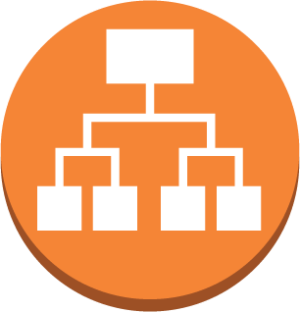
Simple, single cluster with reporting tools (proxy routing)
Availability Zone
Availability Zone
Public Subnet
Public Subnet
Security Group
6
4
Application Load Balancer
Amazon WorkSpaces
Bastion/RDP
Internet gateway
Amazon S3
7
5
3
Routing Table
Private Subnet
Private Subnet
2
Cluster Subnet Group
1
Third Party Reporting
Redshift Cluster
Notes:
1. In this architecture, rather than deploying to public subnets, we recommend that Redshift be run in private subnets, which gives you the maximum security and control over how connections are made to the Cluster.
2. In this architeture, our Cluster Subnet group spans only the private subnets in our VPC
3. For this architecture, you'll [create a more advanced VPC Routing Table](https://docs.aws.amazon.com/AmazonVPC/latest/UserGuide/VPC_Scenario2.html) that will allow connections to resources in Public Subnets from the Internet Gateway, but only allow connections to the Private Subnets from Public Subnets.
4. As with the previous architecture, connections by end users can be made via Amazon Workspaces, or Bastion hosts. In this architectre, direct external connections to the Redshift cluster must be tunneled via SSH, which provides an extra level of security and authentication for connections from outside the VPC. Most advanced query tools support SSH tunnels.
5. Web connections made from your end users will terminate on an [Application Load Balancer (ALB)](https://docs.aws.amazon.com/elasticloadbalancing/latest/application/introduction.html) which is presented in a Public Subnet. This allows your third-party reporting servers (such as Tableau or Looker) to be deployed into Private Subnets, and increases the control you have over where connections originate and how they are handled. In some cases, the third-party software vendor may not support ALB, in which case you can use a Classic Load Balancer (ELB) instead.
6. Your Redshift Cluster, Reporting Server, Workspaces, Bastion/RDP Hosts and ALB can all share a [VPC Security Group](https://docs.aws.amazon.com/AmazonVPC/latest/UserGuide/VPC_SecurityGroups.html), which is a software filewall that allows connections only from members of the group, and on only the ports that you configure.
7. When Redshift connects to Amazon S3, it will route out of your VPC via an Internet Gateway, where it will then hit the S3 endpoint for the specified region.

Slide 9



Simple, single cluster with reporting tools (direct connect routing)
Availability Zone
Availability Zone
5
Private Subnet
1
Private Subnet
Security Group
3
Private Virtual Interface
AWS Direct Connect
Cluster Subnet Group
6
2
Application Load Balancer
Third Party Reporting
4
4
Amazon S3
S3 Endpoint
Redshift Cluster
S3 Endpoint
Notes:
1. As with the architecture that uses Public Routing, we'll build this architecture on the AWS [Amazon Virtual Private Cloud (VPC)](https://aws.amazon.com/vpc), but instead of using Public Subnets, this VPC will only have Private Subnets. Also, as with public routing, we'll create a [Cluster Subnet Group](https://docs.aws.amazon.com/redshift/latest/mgmt/working-with-cluster-subnet-groups.html) that spans AZ's to facilitate cluster restores and high availability.
2. Also similar to the Public Routing architecture, third-party reporting tools will be created within the private subnets where the Redshift clusters can be deployed. However, in this model, the Application Load Balancers aren't in public subnets, but also in the same private subnets. This gives a convenient way for clients to connect to the third-party servers, as well as supporting upgrades to new versions etc.
3. As with the Public Routing architecture, the Redshift Cluster and third-party reporting tools are in the same VPC Security Group. This architecture can also support Bastion/RDP hosts for administration, but are omitted for simplicity
4. Redshift clusters that perform COPY/UNLOAD can access Amazon S3 via an [S3 Gateway Endpoint](https://docs.aws.amazon.com/AmazonVPC/latest/UserGuide/vpc-endpoints.html) which exposes S3 within your VPC without requiring an Internet Gateway. In this configuration, [turn on 'Enhanced VPC Routing'](https://docs.aws.amazon.com/redshift/latest/mgmt/enhanced-vpc-working-with-endpoints.html) within your Redshift cluster configuration.
5. This architecture is designed secure connections to Redshift that come from only authorised endpoints on the other side of a private connection. Amazon [DirectConnect](https://aws.amazon.com/directconnect) is provisioned in this environment, and provides 1 and 10Gbit connections over private leased lines, directly into AWS Regions. In this model, you may also wish to [build hardware based VPN](https://aws.amazon.com/premiumsupport/knowledge-center/create-vpn-direct-connect/) tunnels over the DirectConnect.
6. Once the DirectConnect connection is in place, it can be exposed to one or more VPC's via [Private Virtual Interfaces (VIF)](https://docs.aws.amazon.com/directconnect/latest/UserGuide/WorkingWithVirtualInterfaces.html). This VIF is configured to allow routing into all Private Subnets in the VPC, which will enable end user customers in corporate offices, or applications in a corporate data centre, to connect directly to Redshift or third-party reporting servers.

Slide 10

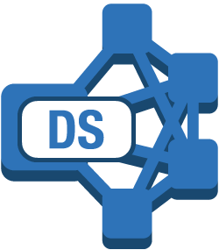





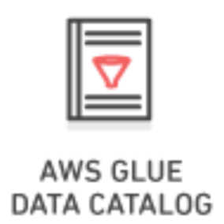
ETL Cluster with multiple line-of-business reporting clusters
COPY/UNLOAD Utility
A cluster is provided to perform high-performance data load and transformation jobs
Data is unloaded to S3 for query by Spectrum or other DBS Services
Data is loaded into Reporting Clusters based on line of business or user group requirements, and can be sized to meet performance needs
4
Reporting Cluster 1
Reporting Cluster 2
Reporting Cluster 3
6
On-premises Database
AWS DMS
1
Spectrum
Raw Data
Amazon S3
ELT Cluster
3
Final Data
Amazon S3
2
Amazon Athena
5
Notes:
1. In this architecture, all your raw data is received into a primary cluster which is used for Extract/Load/Transform operations. This will include receiving raw data feeds from Amazon S3, but also may include on-premises RDBMS data being replicated into Redshift with AWS [Data Migration Service (DMS)](https://aws.amazon.com/dms).
2. Data in your primary cluster is transformed using 'pushdown SQL' operations, where data is manipulated in bulk using SQL statements directly, or through views. This will take advantage of the massively parallel nature of Redshift to transform the data, and may be done through a scheduler or a third-party ETL tool like [Talend](https://aws.amazon.com/marketplace/seller-profile?id=94c7a8d1-1a64-4a59-b364-9248619fb75f) or [Matillion](https://aws.amazon.com/marketplace/pp/B010ED5YF8?qid=1524495459622&sr=0-2&ref_=srh_res_product_image).
3. The [Redshift UNLOAD/COPY utility](https://github.com/awslabs/amazon-redshift-utils/tree/master/src/UnloadCopyUtility) can be used to export a copy of data after transformation to a form suitable for query analysis. This data should be compressed, and will typically take the form of a separate S3 prefix per table, and then additional prefixes for date based partitions. It's a best practice to create separate prefixes for Year, Month and Day. If you use [Hive Dynamic Partition](https://cwiki.apache.org/confluence/display/Hive/DynamicPartitions) notation in the S3 prefix structure (of the form `/PartitionColumnName=PartitionValue/`, then partitions will be automatically recognised by most query tools.
4. Data can be loaded using the UNLOAD/COPY utility into any number of additional Redshift clusters. Each of these clusters can select a [node type and count](https://docs.aws.amazon.com/redshift/latest/mgmt/working-with-clusters.html#rs-about-clusters-and-nodes) that meet the needs of the particular business unit.
5. Final data in S3 should be analyzed by [AWS Glue Crawlers](https://docs.aws.amazon.com/glue/latest/dg/add-crawler.html) on a periodic basis, and it will be entered into the Glue Data Catalog.
6. The same final data that is loaded directly into multiple business line clusters can also be presented to a group of end users via raw queries using S3 data via Redshift Spectrum. This is a good option if users of this cluster have a read-only use case and local storage is not required.

Slide 11


Spectrum Multi-Cluster
Multiple clusters are used to share load across many users
Data resides in a query optimised format such as ORC or Parquet in Amazon S3
Redshift Spectrum is used for queries against external tables
Route53 Hosted Zone exposes user friendly CNAMEs for clusters, using equal weighted round robin distribution
Additional user capacity can be added by launching more Redshift Clusters and adding CNAME to Hosted Zone
5
Hosted Zone
Weighted Round Robin Distribution. P=.33
Amazon Route 53
CNAME: mycluster2
CNAME: mycluster1
CNAME: mycluster2
3
Reporting Cluster 1
Reporting Cluster 2
Reporting Cluster 3
4
Spectrum
2
1
Columnar Compressed Data
Amazon S3
Notes:
1. In this architecture, your data is stored on Amazon S3 in an columnar compressed format such as [Orc or Parquet](https://docs.aws.amazon.com/redshift/latest/dg/c-spectrum-data-files.html). This data will be organised using a S3 prefix structure that enables easy navigation by business unit, as well as providing for simple security rules in S3.
2. This compressed data will be crawled by AWS Glue Crawlers and entered into the AWS Glue Data Catalog. This will include all the relevant file attributes to create a table, as well as [containing references to Hive Partitions based on S3 prefixes](https://docs.aws.amazon.com/glue/latest/dg/aws-glue-programming-etl-partitions.html).
3. Create multiple Redshift Clusters, each sized for the capacity that you need to deliver to one set of end users. These clusters will typically be of heterogenous size and instance type, but can differ depending on use.
4. [Create Redshift Spectrum External Schemas](https://docs.aws.amazon.com/redshift/latest/dg/c-spectrum-external-schemas.html) which allow each cluster to see the data in the Glue Data Catalog.
5. If heterogenous cluster configurations are used, then it can also be useful to create a [Route53 Hosted Zone](https://docs.aws.amazon.com/Route53/latest/DeveloperGuide/CreatingHostedZone.html) which provides simple DNS names for each of the clusters. This can be used to expose each cluster to end users, as well as providing a single endpoint which is used to load balance across all clusters in the group.

Slide 12

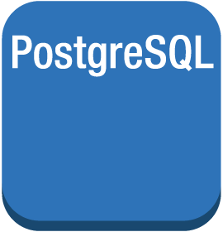
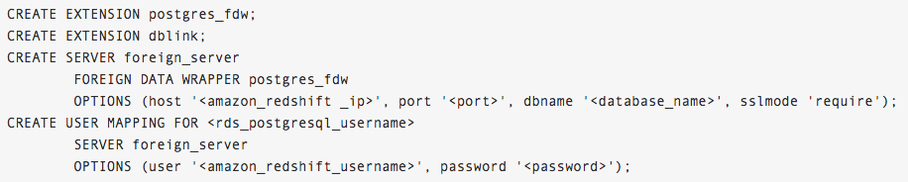
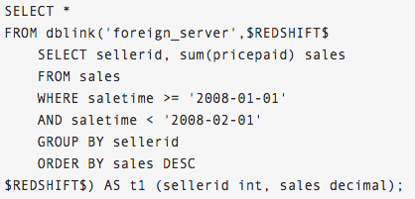
High performance, low latency hybrid cluster
Redshift cluster stores event level granularity data
Create a fleet of RDS Postgres Aurora Instances for low latency data query
Use external database link to query aggregates into RDS Postgres from Redshift cluster
High concurrency web connections
3
Amazon RDS
Read Replica
PostgreSQL Instance
PostgreSQL Instance
Read Replica
4
1
Detail Data Cluster
2
Spectrum
Columnar Compressed Data
Amazon S3
Notes:
1. In this architecture, your cluster is created as normal, and most likely will use the [private](https://github.com/aws-samples/aws-dbs-refarch-redshift/tree/master/private-routing) or [proxy](https://github.com/aws-samples/aws-dbs-refarch-redshift/tree/master/public-routing) routing network deployments
2. Data is ingested directly into the cluster via the COPY command, and data can also be referenced through [external Redshift Spectrum tables](https://github.com/aws-samples/aws-dbs-refarch-redshift/tree/master/spectrum-multicluster)
3. Using Amazon RDS, we create an Aurora Postgres cluster fleet, which exposes a primary database that can be written to, as well as up to 15 Read Replicas which are automatically syncronised to the primary. This cluster can be [configured to autoscale](https://docs.aws.amazon.com/AmazonRDS/latest/UserGuide/Aurora.Integrating.AutoScaling.html) based on a variety of performance metrics, and in this architecture we'd expect to use query rate or connection count for scaling.
4. We then use Postgres features to connect to our Redshift cluster using the Postgres Driver, via a database link. Use the following commands to create the connection to the Redshift cluster from the Aurora Primary:

Slide 13
Integration architectures
Secure cluster with Quicksight
Connectivity from AWS Lambda
AWS Lambda with public AWS services
Data loading with Kinesis Firehose

Slide 14

Secure cluster with Quicksight
Availability Zone
Availability Zone
Public Subnet
Public Subnet
1
Internet gateway
Security Group
Region CIDR */27
Cluster Subnet Group
Amazon QuickSight
Redshift Cluster
2

Slide 15

Connections from AWS Lambda
Availability Zone
Availability Zone
Private Subnet
Private Subnet
Security Group
3
Customer Gateway
Lambda Subnets
AWS Direct Connect
2
Cluster Subnet Group
1
Lambda Function
Redshift Cluster

Slide 16

Connections with Lambda and public AWS services
Availability Zone
Availability Zone
Public Subnet
Public Subnet
1
VPC NAT gateway
VPC NAT gateway
Internet gateway
Lambda Subnets
Security Group
Private Subnet
Private Subnet
Cluster Subnet Group
Lambda Function
Redshift Cluster
Customer Gateway
AWS Direct Connect

Slide 17




Data loading with Kinesis Firehose
Availability Zone
Availability Zone
Public Subnet
Public Subnet
1
Internet gateway
Kinesis Agent
Security Group
Region CIDR */27
Cluster Subnet Group
3
6
On Premises Server
Amazon Kinesis Firehose
5
Kinesis Agent
Redshift Cluster
EC2 Instance
2
4
Amazon S3
Notes:
1. In this architecture, we use the [public routing](../public-routing) model for network deployment
2. Redshift is deployed to a Public Subnet, and the Cluster Security Group is configured to [allow inbound connections from Kinesis Data Firehose](https://docs.aws.amazon.com/firehose/latest/dev/controlling-access.html#using-iam-rs)
3. A Delivery Stream is configured in Kinesis Data Firehose with a target of the Redshift cluster we want to load. In this configuration, we specify how frequently data loads should occur, and/or what the maximum size of loaded files should be. We can configure compression of the data files (recommended) as well as configure the encryption requirements for the data while it is in flight and when stored on Amazon S3. You can also [configure data transformations](https://docs.aws.amazon.com/firehose/latest/dev/data-transformation.html) to occur using AWS Lambda.
4. The Firehose Delivery Stream first stages load data to Amazon S3 in the format specified during configuration
5. Firehose then connects to the cluster, and issues the [COPY command](https://docs.aws.amazon.com/redshift/latest/dg/t_Loading-data-from-S3.html) using a Load Manifest, which causes the cluster to pull the data from Amazon S3 in an optimally parallel fashion.
6. If you want to load file based data, you can configure the [Kinesis Agent](https://github.com/awslabs/amazon-kinesis-agent) on hosts which contain files you want to load into Redshift. This configuration can also include [pre-processing rules](https://aws.amazon.com/blogs/aws/amazon-kinesis-agent-update-new-data-preprocessing-features) to standardize logfile lines into a loadable format.

Slide 18
2
3
1
5
4
5

